Slide 1
Software Configuration Management Patterns
Lecturer: Ngo Huy Bien
Software Engineering Department
Faculty of Information Technology
VNUHCM - University of Science
Ho Chi Minh City, Vietnam
nhbien@fit.hcmus.edu.vn

Slide 2

Objectives

Slide 3

References
Software Configuration Management Patterns: Effective Teamwork, Practical Integration By Stephen P. Berczuk, Brad Appleton, 2002.

Slide 4
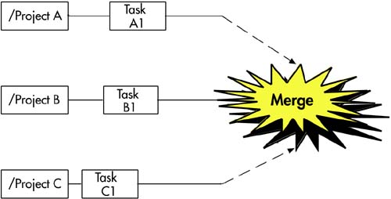
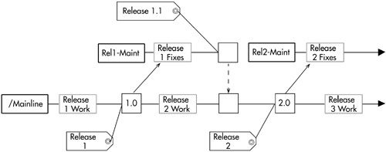
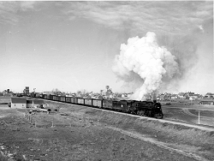
Mainline
How do you keep the number of currently active codelines to a manageable set and avoid growing the project's version tree too wide and too dense? How do you minimize the overhead of merging?
When you are developing a single product release, develop off of a mainline. A mainline is a "home codeline" that you do all your development on except in special circumstances. When you do branch, consider your overall strategy before you create the branch. When in doubt, go for a simpler model.

Slide 5
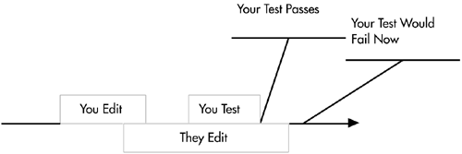

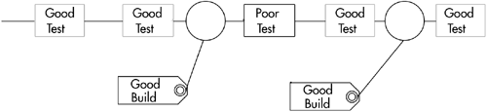
Active Development Line
How do you keep a rapidly evolving codeline stable enough to be useful?
Institute policies that are effective in making your main development line stable enough for the work it needs to do. Do not aim for a perfect active development line but for a mainline that is usable and active enough for your needs.

Slide 6
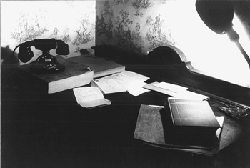
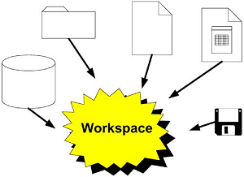
Private Workspace
How do you do keep current with a continuously changing codeline and also make progress without being distracted by your environment changing out from under you?
Do your work in a private workspace, where you control the versions of code and components you are working on. You will have total control over when and how your environment changes.
Get up to date
Make your changes
Do a Private System Build
Test your change
Update the workspace to the latest versions of all other components by getting the latest versions of all components you have not changed.
Rebuild

Slide 7
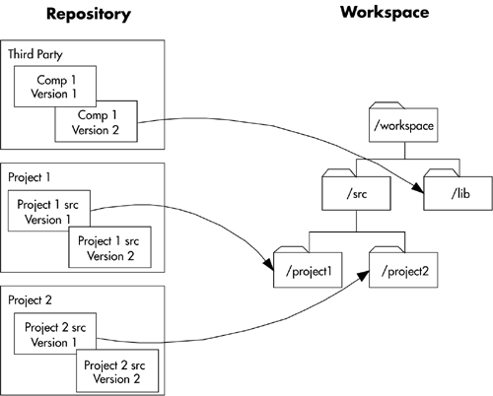
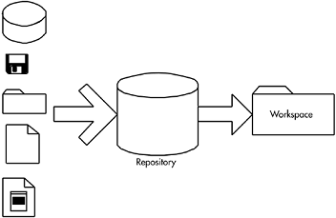
Repository
How do you get the right versions of the right components into a new workspace?
Have a single point of access, or a repository, for your code and related artifacts. Make creating a developer workspace as simple and transparent as possible.

Slide 8
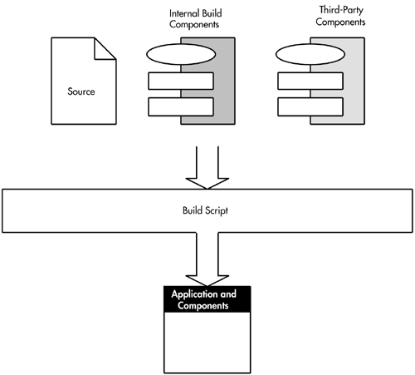
Private System Build
How do you verify that your changes do not break the build or the system before you check them in?
Before making a submission to source control, build the system using a Private System Build similar to the nightly build.
Include all dependencies.
Can be done in an IDE or other development environment
Can skip steps that insert identifying information into the final product
Can skip some packaging steps

Slide 9
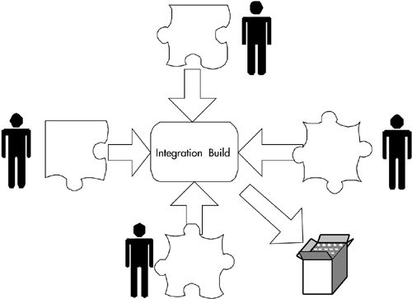
Integration Build
How do you make sure that the code base always builds reliably?
Be sure that all changes (and their dependencies) are built using a central integration build process.
Reproducible.
As close as possible to the final product build.
Automated or requiring minimal intervention to work.
A notification or logging mechanism to identify errors and inconsistencies.

Slide 10
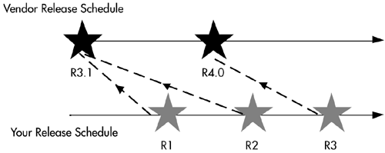

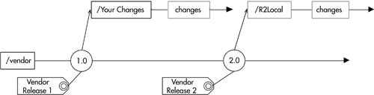
Third Party Codeline
What is the most effective strategy to coordinate versions of vendor code with versions of product code?
Create a codeline for third-party code. Build workspaces and installation kits from this codeline.
Add the vendor code to the appropriate directory of a vendor codeline.
Label the check-in point
Immediately branch this new codeline.
Check in derived objects here to save time and effort
When a new vendor release appears, add it to the mainline portion of the vendor codeline.
Branch again, and merge any relevant changes from the
prior branch into the new branch.

Slide 11

Task Level Commit
How much work should you do between submissions to the version control system? How long should you wait before checking files in?
Do one commit per small-grained, consistent task.

Slide 12
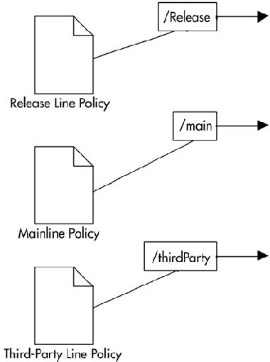
Codeline Policy
How do the developers know which codeline to check their code in to, when to check it in, and what tests to run before check-in?
For each branch or codeline, formulate a policy that determines how and when developers should make changes. The policy should be concise and auditable.
The kind of work encapsulated by the codeline
How and when elements should be checked in, checked out, branched, and merged
Access restrictions for various individuals, roles, and groups
Import/export relationships
The expected activity load and frequency of integration

Slide 13
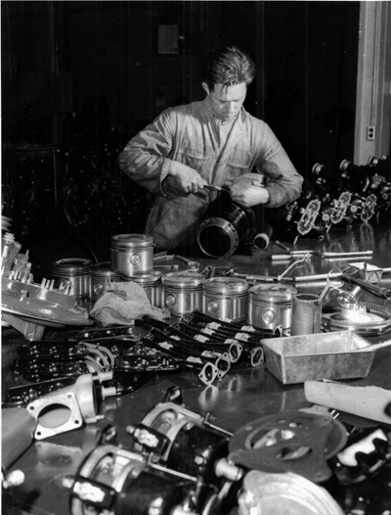
Unit Test
How do you test whether a module still works as it should after you make a change?
Develop and run unit tests.
It is automatic and self-evaluating.
It is fine-grained.
It is isolated.
It tests the contract.
It is simple to run.
You should run unit tests while you are coding

Slide 14
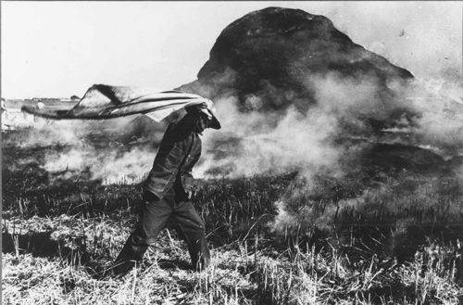
Smoke Test
How do you know that the system will still work after you make a change?
Subject each build to a smoke test that verifies that the application has not broken in an obvious way.
Be quick to run, where "quick" depends on your specific situation
Be self-scoring, as any automated test should be
Provide broad coverage across the system that you care about
Be runnable by developers as well as part of the quality assurance process

Slide 15

Regression Test
How do you ensure that existing code doesn't get worse as you make other improvements?
Run regression tests on the system whenever you want to ensure stability of the codeline, such as before you release a build or before a particularly risky change. Create the regression tests from test cases the system has failed in the past.
Problems that you find in the prerelease QA process
Customer- and user-reported problems
System-level tests based on requirements

Slide 16
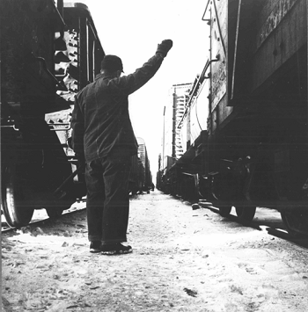

Release Line
How do you do maintenance on released versions without interfering with your current development work?
Split maintenance/release and active development into separate codelines. Keep each released version on a release line. Allow the line to progress on its own for bug fixes. Branch each release from mainline.

Slide 17
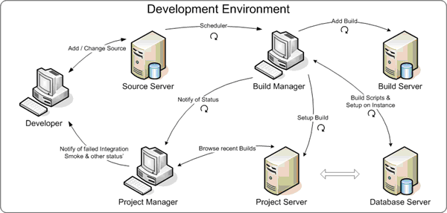
Development Enviroment
Source Server is the source-code repository for version-control.
Build Server is a Build Management repository, ideal for continuous-integration, smoke testing etc.
Benefits:
Static Code-Analysis
Code Documentation
No dependency on Development Team for builds
Focused teams, enhanced productivity
Project Server is the hosting environment for latest/recent builds submitted by Build Server.

Slide 18
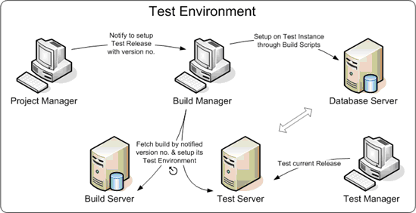
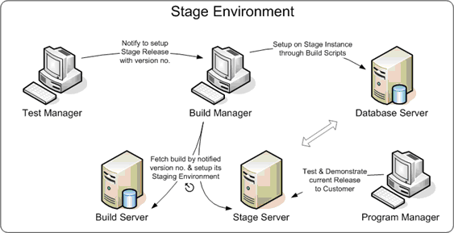
Test And Stage Enviroment

Slide 19
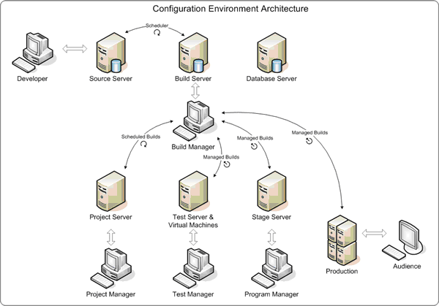
Configuration Enviroment Architecture
Benefits:
It minimizes integration risk
It reduces the risk of low quality
It supports easier defect diagnosis
It improves morale

Slide 20

Thank you for your time

